Slide 1
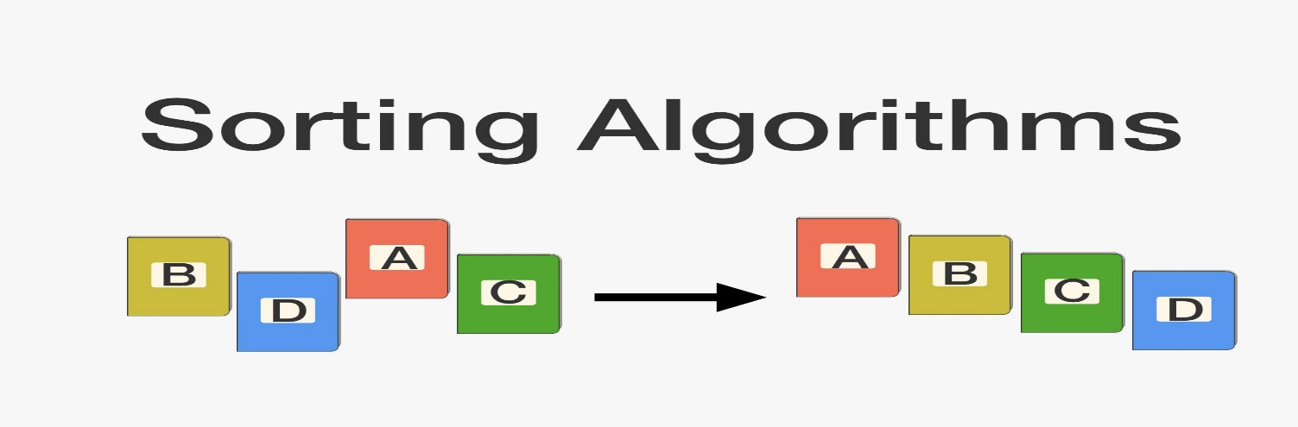
CSE214: Algorithms
Divide and Conquer Approach
and
Merge Sort
‹#›
Notes:
‹#›

Slide 2
Today’s Contents
Divide and Conquer Approach
Merge Sort
Complexity Analysis
Questions for You!
‹#›
Notes:
‹#›

Slide 3
Divide & Conquer Approach
The divide-and-conquer paradigm involves three steps at each level of the recursion:
Divide the problem into a number of subproblems.
Conquer the subproblems by solving them recursively. If the subproblem sizes are small enough, however, just solve the subproblems in a straightforward manner.
Combine the solutions to the subproblems into the solution for the original problem.
‹#›
Notes:
‹#›

Slide 4
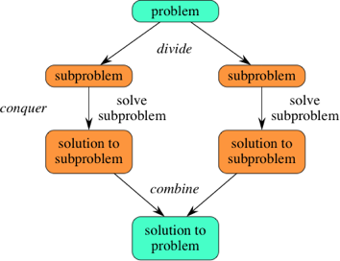
Divide & Conquer Approach
‹#›
Notes:
‹#›

Slide 5
Merge Sort
The merge sort algorithm closely follows the divide-and-conquer paradigm.
Intuitively, it operates as follows.
Divide: Divide the n-element sequence to be sorted into two subsequences of n/2 elements each.
Conquer: Sort the two subsequences recursively using merge sort.
Combine: Merge the two sorted subsequences to produce the sorted answer.
‹#›
Notes:
‹#›

Slide 6
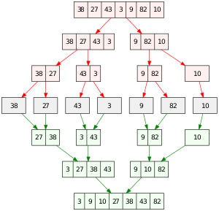
Example
‹#›

Slide 7
p = first Index
r = last index
A[n]
1
2
3
4
5
6
7
8
q ← (p + r) / 2⎦
5
2
4
7
3
1
2
6
⎣
Left Array, L = A(1 , q)
Right Array, R = A[q + 1 , r]
‹#›

Slide 8
p = first Index
r = last index
A[n]
1
2
3
4
5
6
7
8
q ← (p + r) / 2⎦
5
2
4
7
3
1
2
6
⎣
q = (1 + 8 ) / 2 = 4
Left Array, L = A(1 , q)
Right Array, R = A[q + 1 , r]
‹#›

Slide 9
p = first Index
r = last index
Divide
1
2
3
4
5
6
7
8
5
2
4
7
3
1
2
6
q ← (p + r) / 2⎦
⎣
q = (1 + 8 ) / 2 = 4
1
2
3
4
5
6
7
8
5
2
4
7
3
1
2
6
‹#›

Slide 10
⎣
q ← (p + r) / 2⎦
Divide
1
2
3
4
5
6
7
8
5
2
4
7
3
1
2
6
1
2
3
4
5
6
7
8
q = (5 + 8 ) /2
= 6
q = (1 + 4 ) /2
= 2
5
2
4
7
3
1
2
6
‹#›

Slide 11
⎣
q ← (p + r) / 2⎦
Divide
1
2
3
4
5
6
7
8
5
2
4
7
3
1
2
6
1
2
3
4
5
6
7
8
q = (5 + 8 ) /2
= 6
q = (1 + 4 ) /2
= 2
5
2
4
7
3
1
2
6
‹#›

Slide 12
⎣
q ← (p + r) / 2⎦
Divide
1
2
3
4
5
6
7
8
5
2
4
7
3
1
2
6
1
2
3
4
5
6
7
8
q = (5 + 8 ) /2
= 6
q = (1 + 4 ) /2
= 2
5
2
4
7
3
1
2
6
1
2
3
4
5
6
7
8
5
2
4
7
3
1
2
6
‹#›

Slide 13
⎣
q ← (p + r) / 2⎦
Divide
1
2
3
4
5
6
7
8
5
2
4
7
3
1
2
6
1
2
3
4
5
6
7
8
5
2
4
7
3
1
2
6
1
2
3
4
5
6
7
8
5
2
4
7
3
1
2
6
‹#›

Slide 14
Divide
1
2
3
4
5
6
7
8
5
2
4
7
3
1
2
6
1
2
3
4
5
6
7
8
5
2
4
7
3
1
2
6
1
2
3
4
5
6
7
8
5
2
4
7
3
1
2
6
1
2
3
4
5
6
7
8
5
2
4
7
3
1
2
6
‹#›

Slide 15
Conquer
and
Merge
1
2
3
4
5
6
7
8
1
2
2
3
4
5
6
7
1
2
3
4
5
6
7
8
2
4
5
7
1
2
3
6
1
2
3
4
5
6
7
8
2
5
4
7
1
3
2
6
1
2
3
4
5
6
7
8
5
2
4
7
3
1
2
6
‹#›

Slide 16
1
2
3
4
5
6
7
8
5
2
4
7
1
3
2
6
Conquer
and
Merge
1
2
3
4
5
6
7
8
5
2
4
7
1
3
2
6
1
2
3
4
5
6
7
8
5
2
4
7
1
3
2
6
1
2
3
4
5
6
7
8
5
2
4
7
1
3
2
6
‹#›

Slide 17
1
2
3
4
5
6
7
8
5
2
4
7
1
3
2
6
Conquer
and
Merge
1
2
3
4
5
6
7
8
5
2
4
7
1
3
2
6
1
2
3
4
5
6
7
8
5
2
4
7
1
3
2
6
1
2
3
4
5
6
7
8
5
2
4
7
1
3
2
6
1
2
3
4
5
6
7
8
2
5
4
7
1
3
2
6
‹#›

Slide 18
1
2
3
4
5
6
7
8
5
2
4
7
1
3
2
6
Conquer
and
Merge
1
2
3
4
5
6
7
8
5
2
4
7
1
3
2
6
1
2
3
4
5
6
7
8
5
2
4
7
1
3
2
6
1
2
3
4
5
6
7
8
5
2
4
7
1
3
2
6
1
2
3
4
5
6
7
8
2
5
4
7
1
3
2
6
1
2
3
4
5
6
7
8
2
4
5
7
1
2
3
6
‹#›

Slide 19
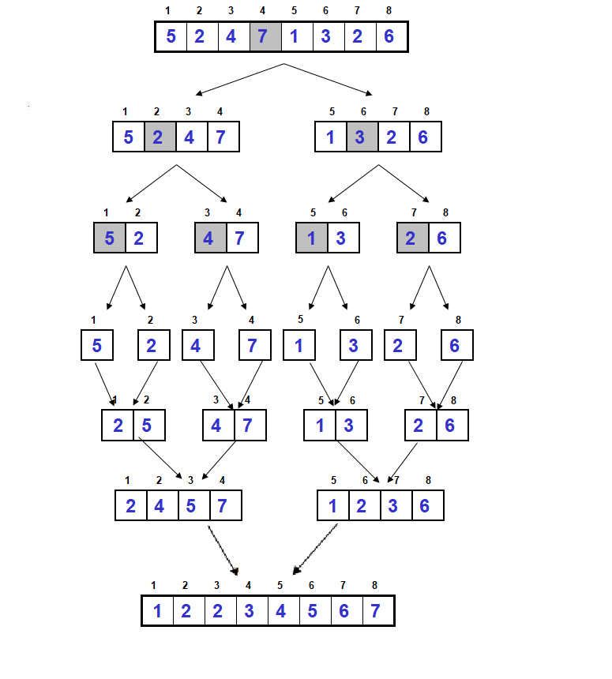
Conquer
and
Merge
‹#›

Slide 20
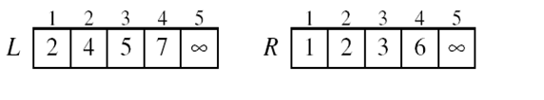
i
j
A
‹#›

Slide 21
i
i
i
i
i
j
j
j
j
j
A
1
2
2
3
4
5
6
7
‹#›

Slide 22
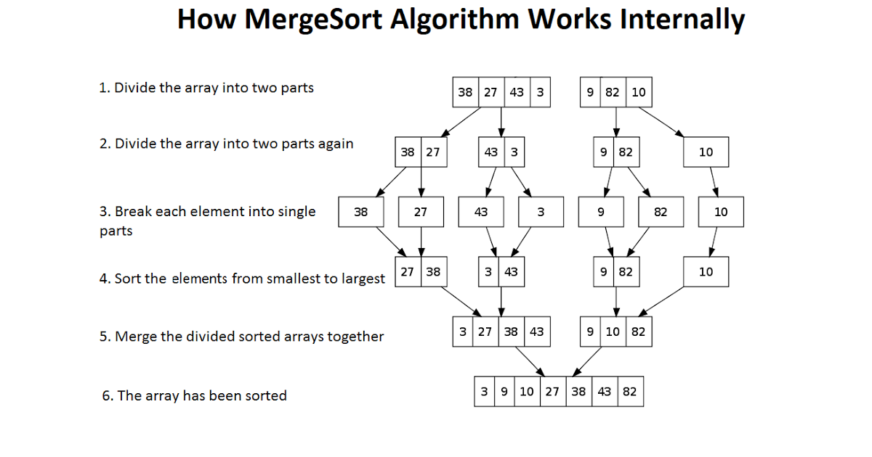
‹#›

Slide 23
Algorithm of Merge Sort
MERGE-SORT(A, p, r)
if ( p < r )
q ← (p + r) / 2 ⎦
MERGE-SORT(A, p, q)
MERGE-SORT(A, q + 1, r)
MERGE(A, p, q, r)
1
2
3
4
5
6
7
8
5
2
4
7
1
3
2
6
⎣
‹#›
Notes:
‹#›

Slide 24
MERGE(A, p, q, r)
n1 = q – p + 1
n2 = r - q
Let L[1 . . n1 + 1] and R[1 . . n2 + 1] be two new arrays
for i = 1 to n1
L[ i ] ← A[p + i - 1]
for j = 1 to n2
R[ j ] ← A[ q + j ]
L[n1 + 1] ← ∞
R[n2 + 1] ← ∞
i ← 1
j ← 1
for k ← p to r
if L[ i ] ≤ R[ j ]
then A[k] ← L[ i ]
i ← i + 1
else A[k] ← R[ j ]
j ← j + 1
1
2
3
4
5
6
7
8
5
2
4
7
1
3
2
6
i
j
A
‹#›
Notes:
‹#›

Slide 25
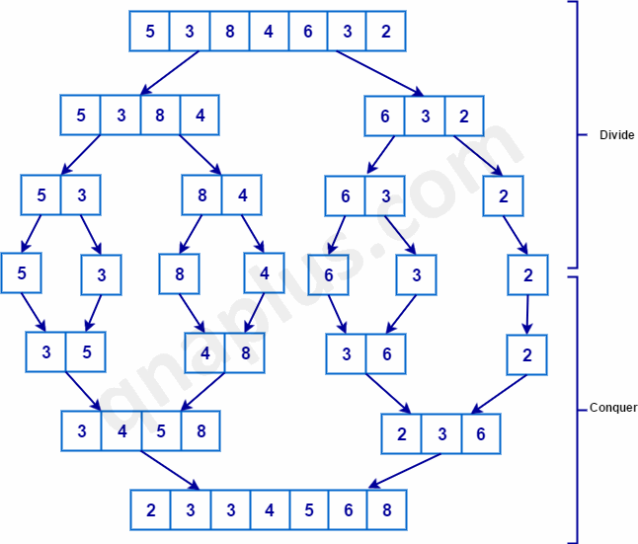
Example
‹#›

Slide 26
Algorithm of Merge Sort
MERGE(A, p, q, r)
n1 = q – p + 1
n2 = r - q
Let L[1 . . n1 + 1] and R[1 . . n2 + 1] be two new arrays
for i = 1 to n1
L[ i ] ← A[p + i - 1]
for j = 1 to n2
R[ j ] ← A[ q + j ]
L[n1 + 1] ← ∞
R[n2 + 1] ← ∞
i ← 1
j ← 1
for k ← p to r
if L[ i ] ≤ R[ j ]
then A[k] ← L[ i ]
i ← i + 1
else A[k] ← R[ j ]
j ← j + 1
MERGE-SORT(A, p, r)
if p < r
q ← (p + r ) / 2
MERGE-SORT(A, p, q)
MERGE-SORT(A, q + 1, r)
MERGE(A, p, q, r)
⎣
⎦
‹#›
Notes:
‹#›

Slide 27
Time Complexity
MERGE-SORT(A, p, r)
if p < r
q ← (p + r ) / 2
MERGE-SORT(A, p, q)
MERGE-SORT(A, q + 1, r)
MERGE(A, p, q, r)
⎣
⎦
T(n/2)
T(n/2)
O(n)
Complexity:
T(n) = [T(n/2) + T(n/2)] * O(n)
= 2T(n/2) * O(n)
= O(logn) * O(n)
= O(nlogn)
‹#›
Notes:
‹#›

Slide 28
Complexity Analysis of Three Algorithms
Algorithm | Best case | Worst case
Selection Sort | O(n²) | O(n²)
Insertion Sort | O(n) | O(n²)
Merge Sort | O(nlogn) | O(nlogn)
‹#›
Notes:
‹#›

Slide 29
Advantage and Drawbacks
Advantages
- Guaranteed to run in O(nlogn)
Disadvantage
- Requires extra space ≈ O(n)
‹#›
Notes:
‹#›

Slide 30
Question for you
Which Algorithm will you choose?
- For Sorted Data List
- For Unsorted Data List
2. Is Merge sort a In-Place Algorithm?
3. Sort the given data set using both the Merge Sort. Show each steps.
26 | 13 | 6 | 8 | 20 | 22 | 13
‹#›
Notes:
‹#›

Slide 31
Some References
https://visualgo.net/en/sorting
‹#›
Notes:
‹#›

Slide 32

Thank you!
‹#›

